Slide 1

Aim:
HDOC day 27
To write a C program to print a full pyramid using asterisks.
Algorithm:
1)Start.
2)Input number of rows n.
3)Run loop from i = 1 to n.
4)Print required spaces.
5)Print 2*i-1 stars.
6)Move to next line.
7)Stop.
C code
#include <stdio.h>
int main()
{
int n,i,j;
printf("Enter rows: ");
scanf("%d",&n);
for(i=1;i<=n;i++)
{
for(j=1;j<=n-i;j++)
printf(" ");
for(j=1;j<=2*i-1;j++)
printf("* ");
}
printf("\n");
}
return 0;

Slide 2
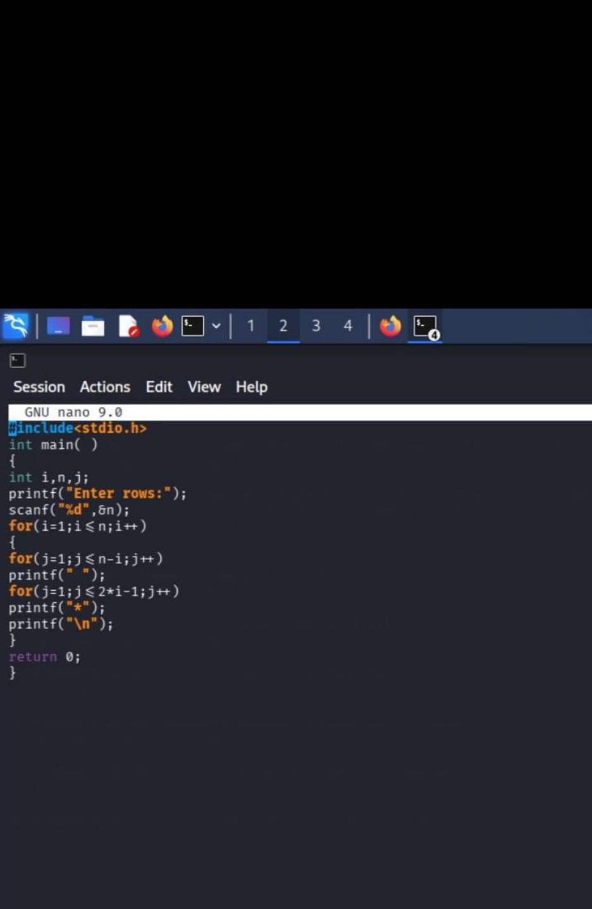

Slide 3
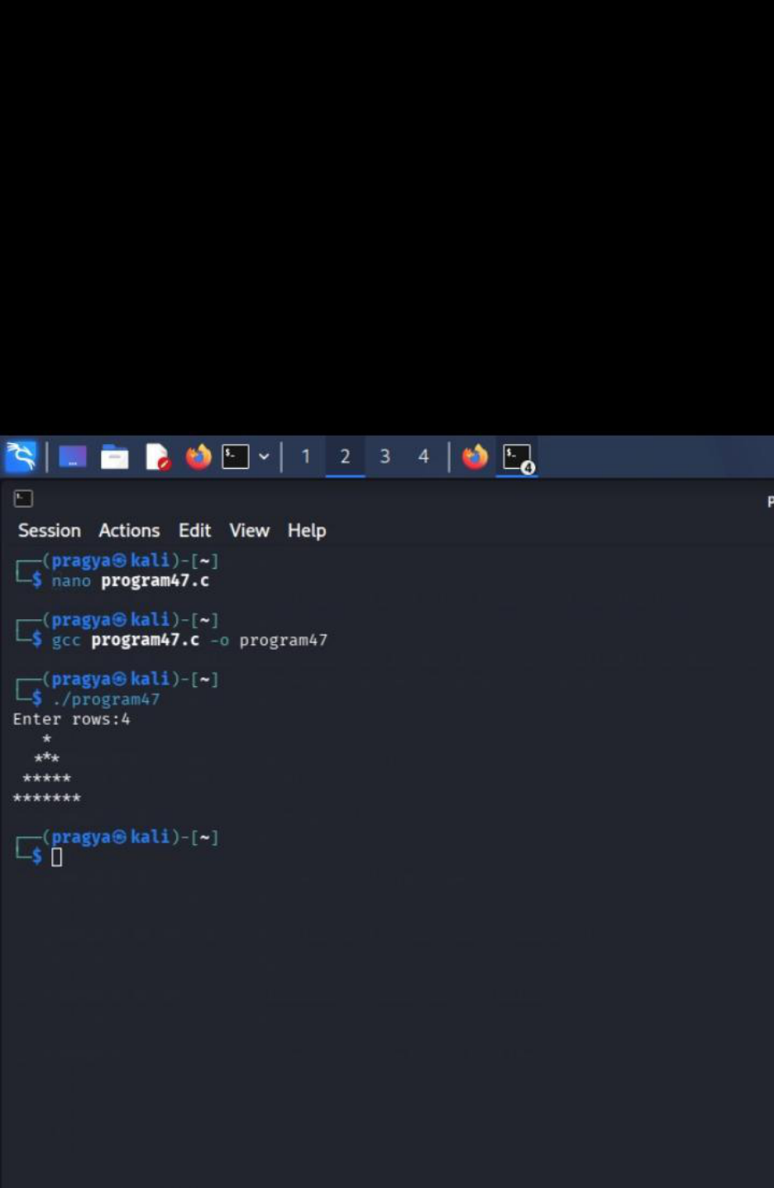

Slide 4
Question 2
To write a C program to print an inverted pyramid using asterisks.
Algorithm
1)Start.
2)Input number of rows n.
3)Run loop from i = n to 1.
4)Print spaces.
5)Print 2*i-1 stars.
6)Move to next line.
7)Stop.
C code
#include <stdio.h>
int main()
{
int n,i,j;
printf("Enter rows: ");
scanf("%d",&n);
for(i=n;i>=1;i--)
{
for(j=1;j<=n-i;j++)
printf(" ");
for(j=1;j<=2*i-1;j++)
printf("* ");
}
printf("\n");
}
return 0;

Slide 5
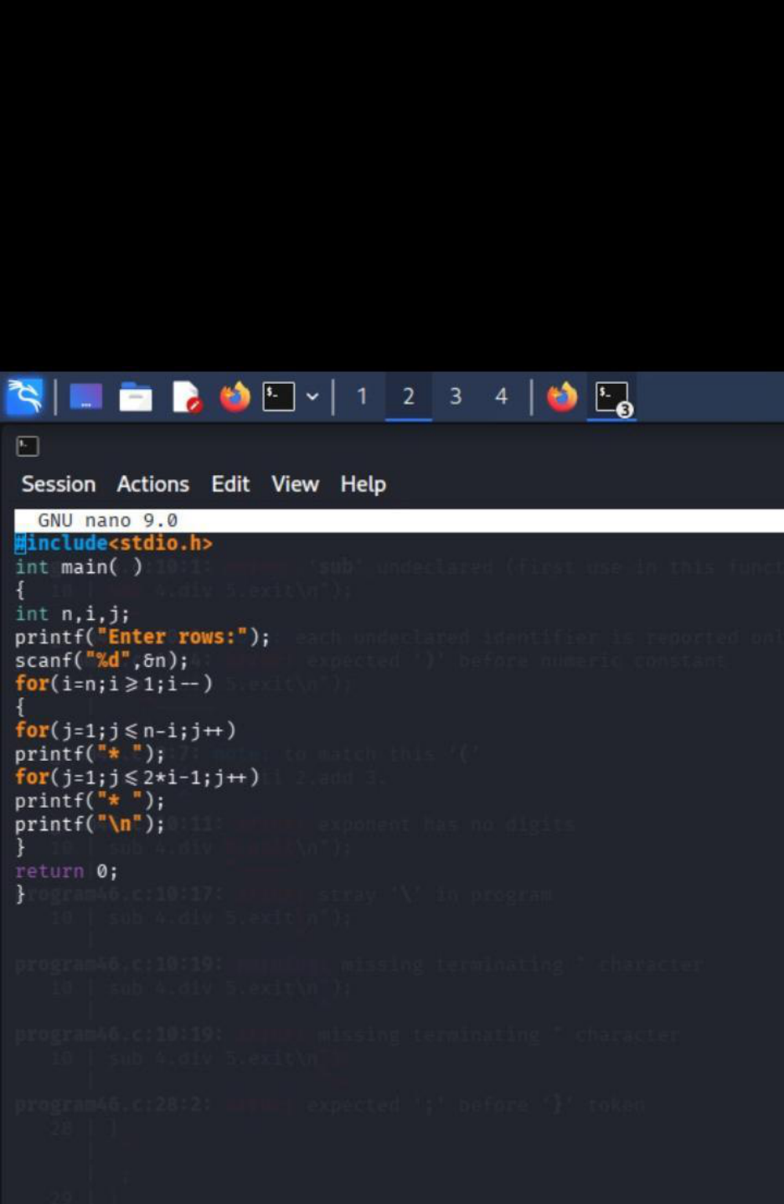

Slide 6
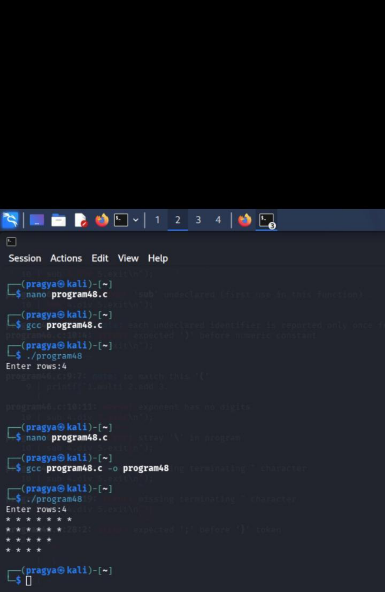

Slide 7
Question 3
To write a C program to print a diamond pattern using asterisks.
Algorithm
1)Start.
2)Input number of rows n.
3)Print the upper pyramid using nested loops.
4)Print the lower inverted pyramid using nested loops.
5)Stop.
C code
#include <stdio.h>
int main()
{
int n,i,j;
printf("Enter rows: ");
scanf("%d",&n);
for(i=1;i<=n;i++)
{
for(j=1;j<=n-i;j++) printf(" ");
for(j=1;j<=2*i-1;j++) printf("* ");
}
printf("\n");
for(i=n-1;i>=1;i--)
{
for(j=1;j<=n-i;j++) printf(" ");
for(j=1;j<=2*i-1;j++) printf("* ");
}
printf("\n");
}
return 0;

Slide 8
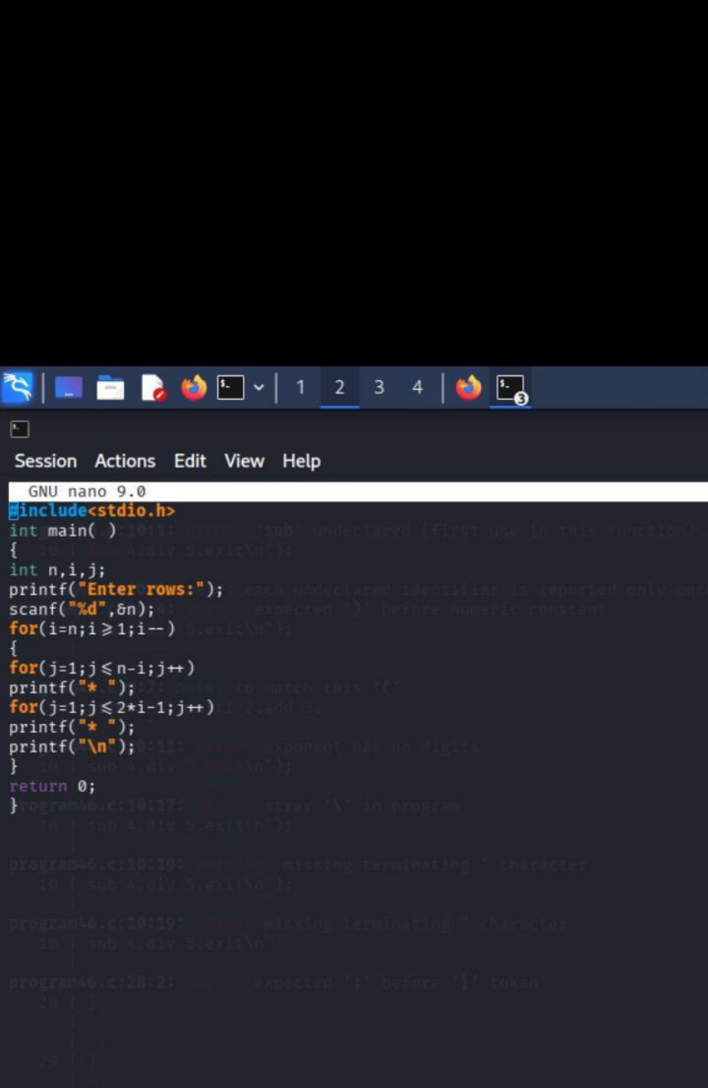

Slide 9
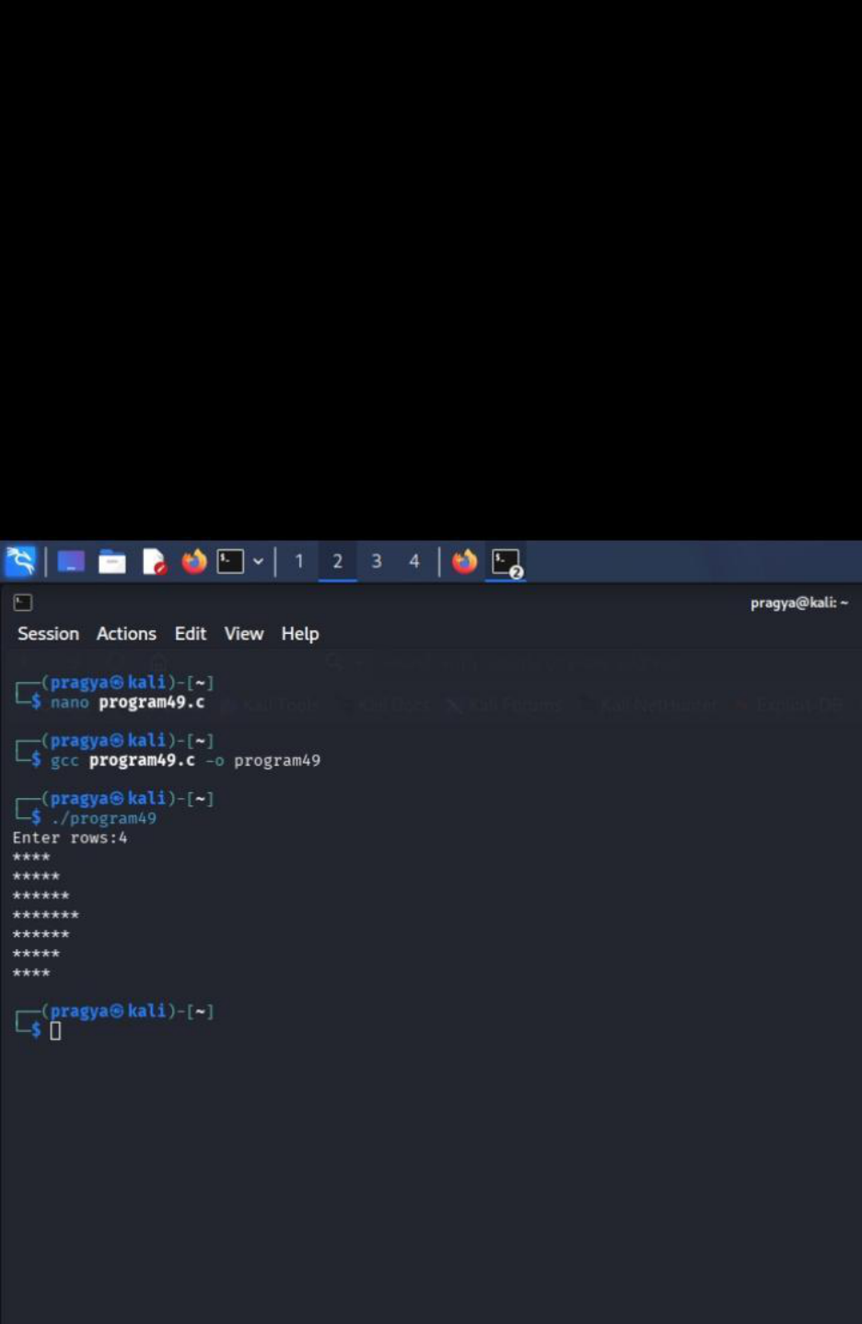

Slide 10
Question 4
To write a C program to print a palindromic number pyramid.
Algorithm
1)Start.
2)Input number of rows n.
3)Run loop from i = 1 to n.
4)Print numbers from 1 to i.
5)Print numbers from i-1 back to 1.
6)Move to the next line.
7)Stop.
C code
#include <stdio.h>
int main()
{
int n,i,j;
printf("Enter rows: ");
scanf("%d",&n);
for(i=1;i<=n;i++)
{
for(j=1;j<=i;j++)
printf("%d ",j);
for(j=i-1;j>=1;j--)
printf("%d ",j);
}
printf("\n");
}
return 0;

Slide 11
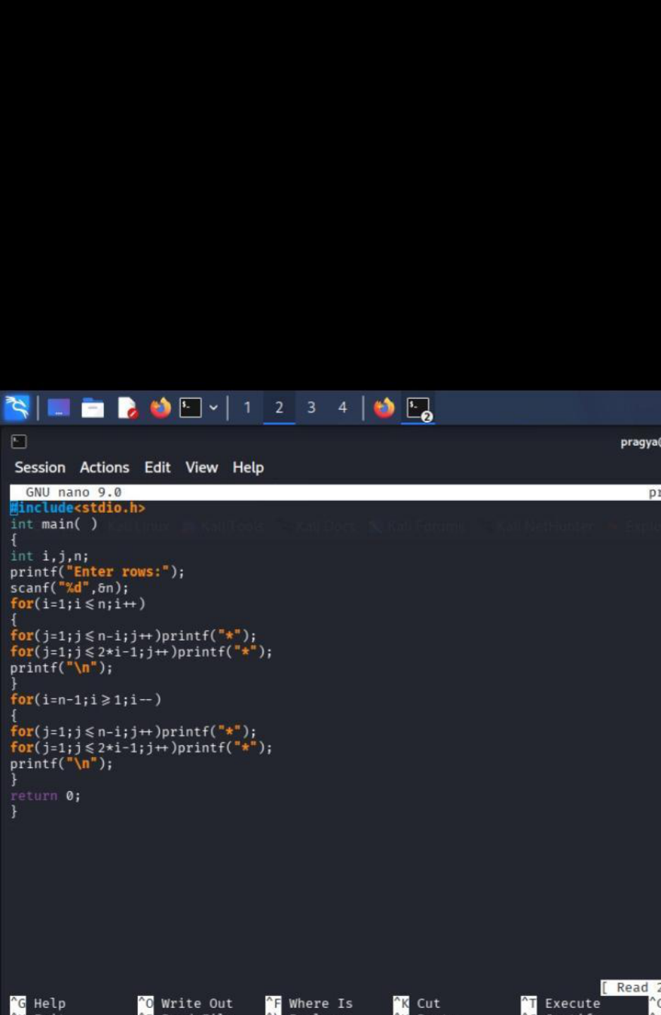

Slide 12
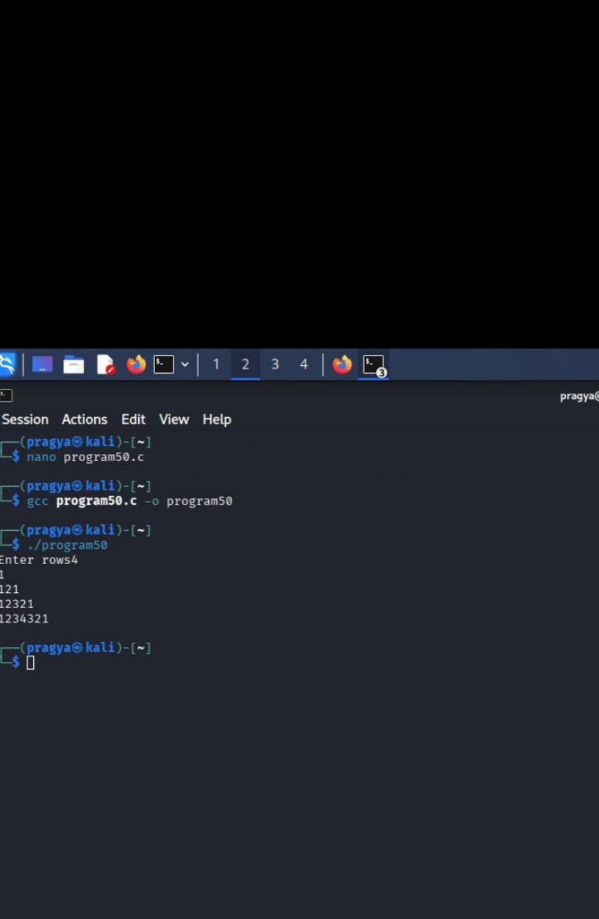

Slide 13
Question 5
To write a C program to print a repeated-number pyramid.
Algorithm
1)Start.
2)Input number of rows n.
3)Run loop from i = 1 to n.
4)Print required spaces.
5)Print row number 2*i-1 times.
6)Move to the next line.
7)Stop.
C code
#include <stdio.h>
int main()
{
int n,i,j;
printf("Enter rows: ");
scanf("%d",&n);
for(i=1;i<=n;i++)
{
for(j=1;j<=n-i;j++)
printf(" ");
for(j=1;j<=2*i-1;j++)
printf("%d ",i);
}
printf("\n");
}
return 0;

Slide 14
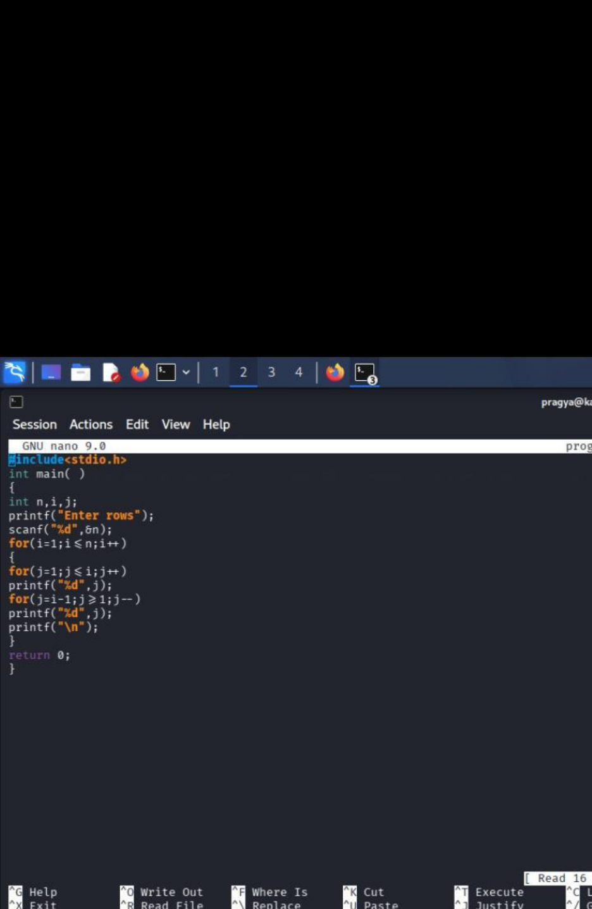

Slide 15
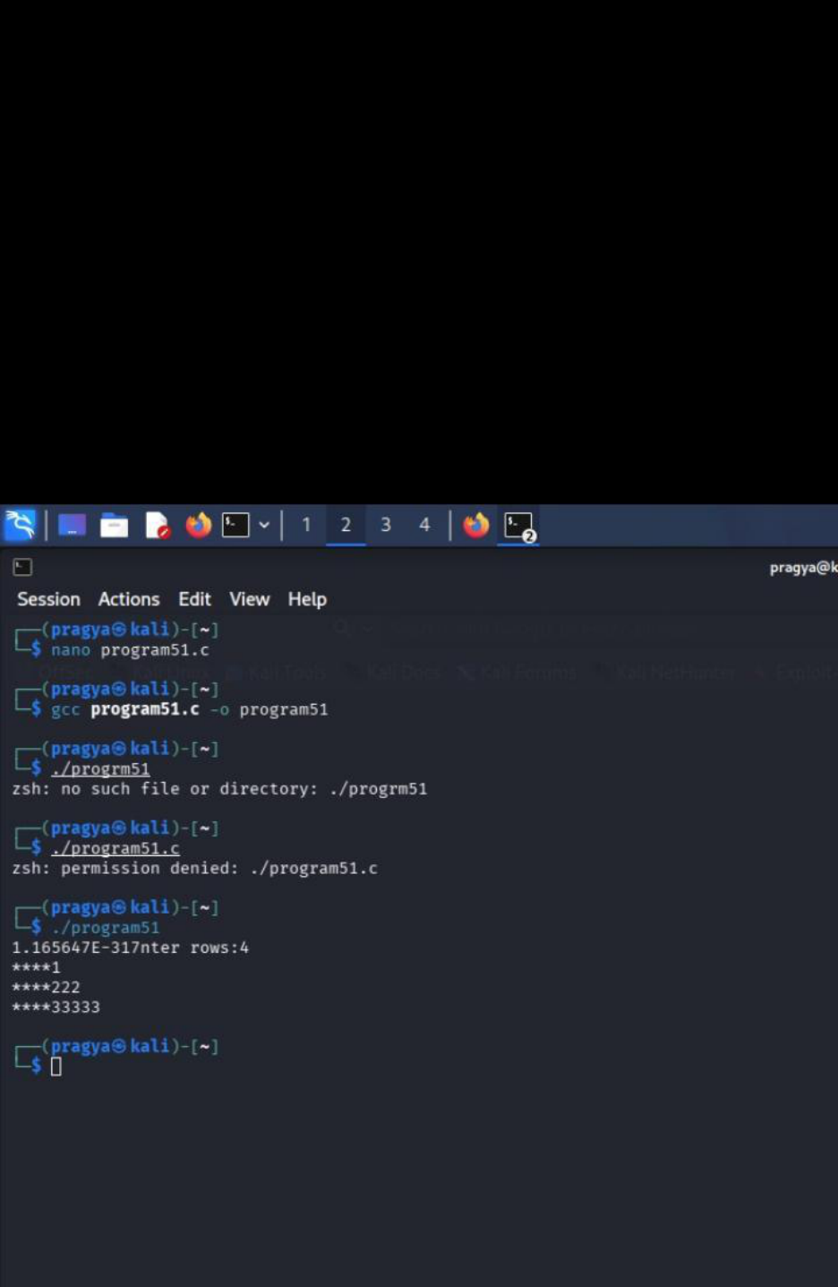

Slide 16
Result
All 5 pattern diamond are successful implemented using nested loops
Thank you
Pragya pandey
Sap id 590034352
Batch 15

